Slide 1
Outline for class
Last week’s concepts and lab
Poll everywhere top disease mortality
Upcoming assignments
Measures of Association/Comparisons

Slide 2
Concepts
Risks
Person time
Rates
Prevalence
Odds

Slide 3
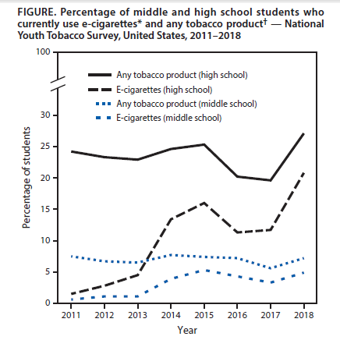
Which measure of occurrence?
MMWR / November 16, 2018 / Vol. 67 / No. 45

Slide 4
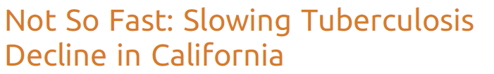

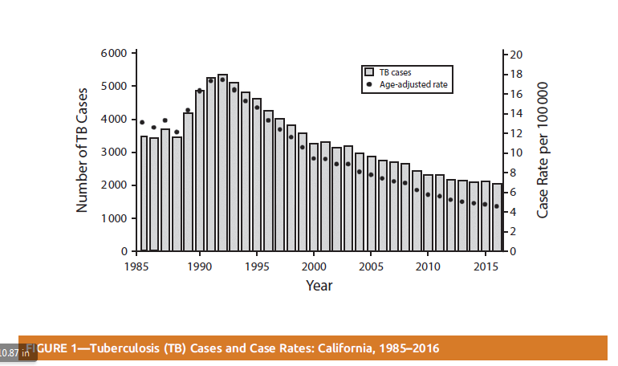
Calculating TB age adjusted rate

Slide 5
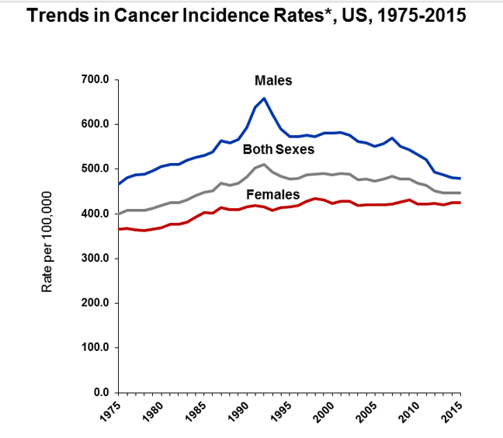
ACS, 2019
Notes:
https://www.cancer.org/research/cancer-facts-statistics/all-cancer-facts-figures/cancer-facts-figures-2019.html

Slide 6
Ways to estimate Person Time
Method A:
Add up the time that each person is at risk (Sum time for each person). Useful when you have the individual records for time under observation for individuals; know timing of disease
Method B: NOTE: what is done MOST of the time
Multiply the average size of the population at risk by the length of the time interval (Take an average of time)
Useful when you have population estimates, but no data on individuals through time (census data)

Slide 7
Last week’s lab key points
True rates incorporate time from participants who were lost to follow up during the study.
Distinguish lost to follow up from missing data
Loss to follow up - Participants drop out of the study
Missing Data -Participants don’t answer every question
With little missing data, exclude data points.
Sensitivity Analysis-run analysis with and without study subjects with missing data. Are results the same?

Slide 8
Last week’s lab key points
With substantial missing data, (~20%+) you may need to resort to statistical techniques such as imputation.
Excluding those lost to follow up made the advertisement appear more effective in promoting smoking cessation.
Loss to follow up can affect results. Pattern of selective drop out by exposure-disease pattern can be different from study to study.

Slide 9
Student Lab Question
Do I express the risk as a percentage or as cases per person?
Consider a calculated risk of 0.0023 (over specified time period)
0.23% (over time period)
0.23 cases per 100 person (over time period)
2.3 cases per 1,000 persons (over time period)

Slide 10
Upcoming Assignments
Friday Jan 25
Measures of comparison/association quiz due
Friday Feb 1
Individual Data Analysis Exam 1 due

Slide 11
What were the top 5 causes of death globally in 2010? Poll everywhere
Population Perspectives Case Study: Global Burden of Disease Lozano et al. 2012

Slide 12
Measures of Comparison & Uncertainty (Confidence Intervals), Population Sampling
EPID600
January 22, 2019
Dr. Karin Yeatts

Slide 13
Course Objectives
Explain the importance of epidemiology for informing scientific, ethical, economic and political discussion of health issues.
Apply the basic terminology and definitions of epidemiology.
Calculate basic epidemiology measures.
ulate basic epidemiology measures.
Identify key sources of data for epidemiologic purposes.
Evaluate the strengths and limitations of epidemiologic reports.
Draw appropriate inferences from epidemiologic data.
Comprehend basic etuse and dissemination of epidemiologic data.
Draw appropriate inferences from epidemiologic data.
Identify the principles and limitations of public health screening programs
Apply concepts, methods, and tools of public health data collection, analysis and interpretation, and the evidence-based reasoning and informatics approaches that are essential to public health practice.

Slide 14
Class Objectives
Define, calculate, and interpret the different types of measures of ratios and differences.
Construct a contingency table to calculate measures of association
Calculate and interpret measures of uncertainty
Identify key sources of data for epidemiologic purposes
Describe population-based sampling

Slide 15
Does X “cause” Y?
X Y

Slide 16
Measures of Association
Compare (/contrast) measures of disease occurrence in two different groups, the exposed group and the unexposed group.
Compare with
division (ratio effect measures)
or
subtraction (difference effect measures)

Slide 17
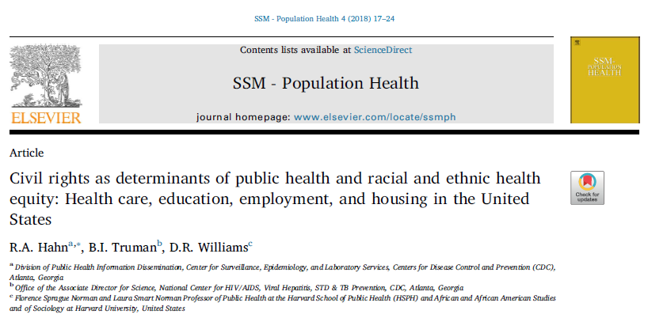
Health Equity Example

Slide 18
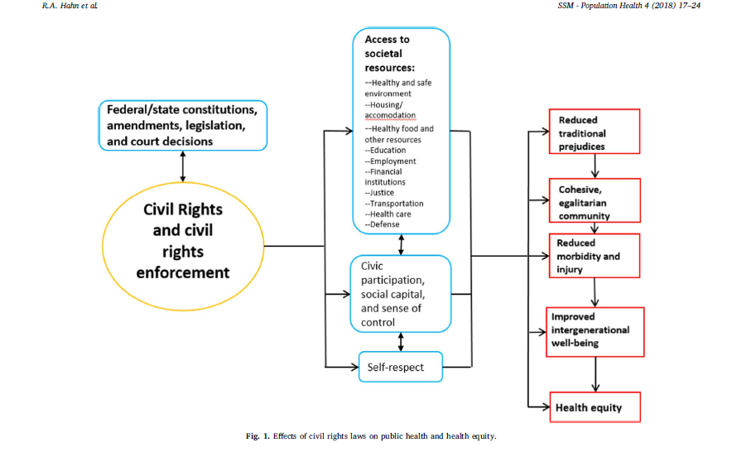
Asking PH Questions-Making Comparisons-Generating Hypotheses-Designing Interventions
Notes:
Civil rights as determinants of public health and racial and ethnic health equity: Health care, education, employment, and housing in the United States.
Hahn RA, Truman BI, Williams DR.
SSM Popul Health. 2018 Apr;4:17-24. doi: 10.1016/j.ssmph.2017.10.006.

Slide 19
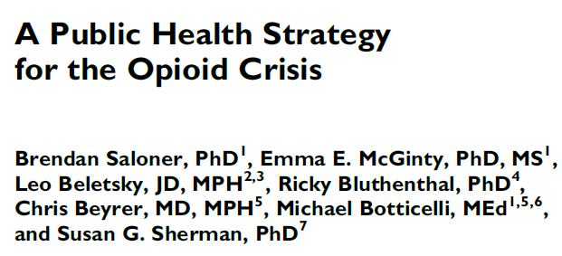

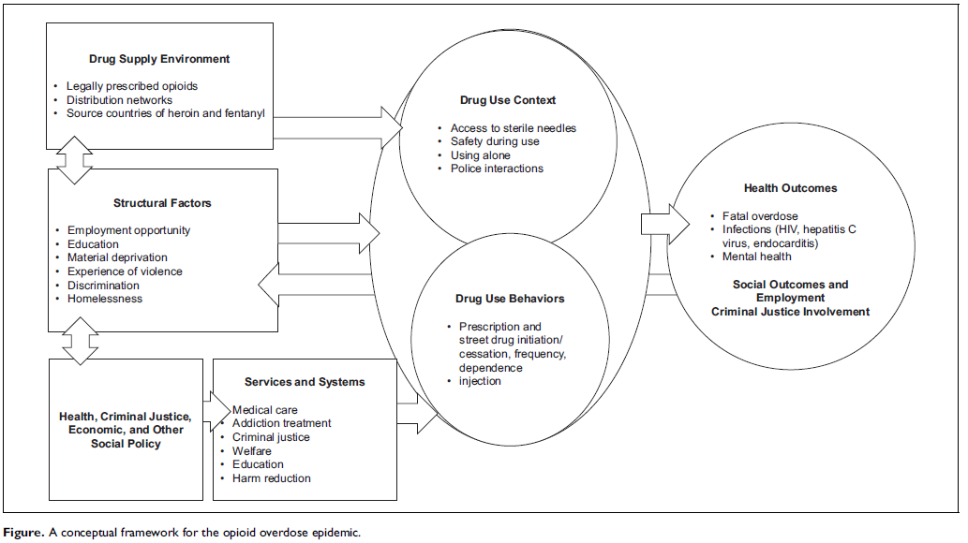

Slide 20
Two-by-Two Tables
(contingency tables)

Slide 21
Two-by-Two Tables
(contingency tables)
Notes:
The 2 by 2 table start with a square cordoned into 4 spaces.

Slide 22
Two-by-Two Tables
(contingency tables)
Exposed
Non-Exposed

Slide 23
Two-by-Two Tables
(contingency tables)
Non-Diseased
Diseased
Exposed
Non-Exposed

Slide 24
Two-by-Two Tables
(contingency tables)
Non-Diseased
Diseased
Exposed
a
b
Non-Exposed
c
d

Slide 25
Two-by-Two Tables
(contingency tables)
Non-Diseased
Diseased
Exposed
a
b
(a+b)
Non-Exposed
c
d
(c+d)

Slide 26
Non-Diseased
Diseased
Exposed
a
b
(a+b)
Non-Exposed
c
d
(c+d)
Risk exp = a/(Total Exposed) = a/(a+b)
Risk unexposed = c/ (Total Unexposed) = c/(c+d)

Slide 27
Non-Diseased
Diseased
a
b
(a+b)
E
c
d
(c+d)
E
Risk exp = a/(Total Exposed) = a/(a+b)
Risk unexposed = c/ (Total Unexposed) = c/(c+d)

Slide 28
D
D
a
b
(a+b)
E
c
d
(c+d)
E
Risk exp = a/(Total Exposed) = a/(a+b)
Risk unexposed = c/ (Total Unexposed) = c/(c+d)

Slide 29
Risk Ratio and Risk Difference
D
D
-
RD= (Rexp)
(Runexp)
a
b
(a+b)
E
RR= (Rexp)
(Runexp)
c
d
E
(c+d)
Risk exp = a/(Total Exposed) = a/(a+b)
Risk unexposed = c/ (Total Unexposed) = c/(c+d)

Slide 30
Traffic
Accident
NO Traffic
Accident
Texting
while driving
(E)
a = 30
b = 300
Total Exposed
(a+b) = 330
NOT texting
while driving
(E)
c = 5
d = 450
Total Unexposed
(c+d) = 455
Total disease
Total NO disease
Riskexp = = a/(a+b) =30/330 = 9.09 cases per 100 persons
Riskunexposed =) = c/(c+d) = 5/455 = 1.10 cases per 100 persons

Slide 31
Traffic
Accident
NO Traffic
Accident
Texting
while driving
(E)
a = 30
b = 300
Total Exposed
(a+b) = 330
NOT texting
while driving
(E)
c = 5
d = 450
Total Unexposed
(c+d) = 455
Total disease
Total NO disease
Risk Ratio exposed vs. unexposed = (30/330)/(5/455) = 8.27
Risk Difference exposed vs. unexposed = (30/330)-(5/455)
= 7.99 cases per 100 persons

Slide 32
Risk ratio
Among those that texted while driving, the risk of have a traffic accident was approximately eight times as likely compared with those who did not text while driving, over a one year time period.
Risk difference
Among those that texted while driving, the risk of traffic accidents was 7.99 cases per 100 persons higher than those who did not text while driving over a one year period.
(No units)
(Includes units)

Slide 33
“More than, less than”
If you add words like “greater” or “higher” or “more”.. (when ratio>1.0), you have to subtract 1 from your measure of effect: Example for a risk ratio: Those that texted while driving were approximately seven times more likely to have a traffic accident compared with those who did not text while driving over a 1 year time period.
If you use words like “less” or lower, (when ratio < 1.00), you have to subtract the ratio measure from 1.

Slide 34
Risk ratio
Among those that texted while driving, the risk of have a traffic accident was approximately seven times more likely compared with those who did not text while driving, over a one year time period.
(No units)

Slide 35
Rate Ratio and Rate Difference
D
Person-time
-
RD= (IRexp)
(IRunexp)
a
PTexp
(a+b)
E
RR= (IRexp)
(IRunexp)
c
PTunexp
E
(c+d)
Total Disease
Rate exp = a/(Total Person-time Exposed) = a/(PTexp)
Rate unexposed = c/ (Total Person-time Unexposed) = c/PTunexp)

Slide 36
Traffic
Accident
Person-years
Texting
while driving
(E)
a = 30
PTexp= 400
NOT texting
while driving
(E)
c = 5
PTunexp = 337
Total traffic accidents
Rate exp =a/(PTexp) = 30/400 = 7.5 cases per 100 py
Rate unexposed = c/(PTunexp) = 5/337 = 1.48 cases per 100 py

Slide 37
Traffic
Accident
Person-years
Texting
while driving
(E)
a = 30
PTexp= 400
NOT texting
while driving
(E)
c = 5
PTunexp = 337
Total traffic accidents
Rate Difference exp vs unexp =(30/400) – (5/337) = 6.02 cases per 100 py
Rate Ratio exp vs. unexp = (30/400)/(5/337) = 5.06
Notes:
Then to calculate the rate difference you subtract the rate in the exposed minus the rate in the exposed to get 6.02 cases per 100 person years.
To get the rate ratio you divide the rate in the exposed by the rate in the unexposed to get 5.06.

Slide 38
Rate ratio
Those that texted while driving had five times the rate of traffic accidents compared with those who did not text while driving.
Rate difference
Among those that texted while driving, the rate of traffic accidents was 6.02 cases per 100 person years higher than the rate among those who did not text while driving.
(No units)
(Includes units)

Slide 39
Relative vs. Absolute Measures of Association Interpretation
Relative
If RR = 1 : No association
If RR > 1 : (+) Risk in exposed is greater than in unexposed
If RR < 1 : (-) Risk in exposed is lower than in unexposed
Absolute
If RD = 0 : No association (same in both groups)
If RD > 0 : (+) Risk in exposed is greater than in unexposed
If RD < 0 : (-) Risk in exposed is lower than in unexposed

Slide 40
Relative Risk: any ratio measure of effect that approximates risk
“Relative risk“ is not precise

Slide 41
Why have both ratios and differences?
 | Lung Cancer | Cardiovascular Disease
Smokers | 48.3 | 294.7
Non Smokers | 4.5 | 169.5
Ratio | 10.8 | 1.7
Difference | 43.8 | 125.1
Mortality Rates per 100,000 person years
J. Fleiss, p. 60

Slide 42
Ratio Measures
Express the strength of association (no units)
Difference Measures
Express the absolute excess of a health outcome attributable to exposure (include units)

Slide 43
What are Confidence Intervals (CIs)?
We calculate estimates of the true value for a measure of occurrence, and a measure of association.
Confidence Intervals answer questions on uncertainty in our data
rejecting null hypothesis/statistical significance
sampling variability
If we sample and construct a confidence interval 100 times, 95 out of 100 confidence intervals are expected to contain the true value.

Slide 44
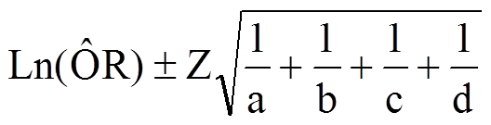
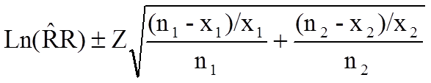
Mathematical Formulas for Confidence IntervaIs for Ratio Measures
Odds Ratio CI
Risk Ratio CI
 | With Outcome | Without Outcome | Total
Exposed Group (1) | x₁ | n₁-x₁ | n₁
Non-exposed Group (2) | x₂ | n₂-x₂ | n₂
http://sphweb.bumc.bu.edu/otlt/MPH-Modules/BS/BS704_Confidence_Intervals/BS704_Confidence_Intervals_print.html

Slide 45
95%
Confidence
Interval
0 1 1.9 2.8 4.1 5
Point
Estimate
Lower
Bound
Upper
Bound

Slide 46
p-value and the 95% CI
The 95% CI has a relationship with the p-value.
Statistical significance occurs when:
p-value is less than alpha (p< 0.05)
a 95% CI does not include the null value
When there is statistical significance, we reject the null hypothesis that there is no association between exposure and outcome.

Slide 47
P values and 95%CIs
P value- the statistical probability of the occurrence of a given finding by chance alone in comparison with the known distribution of possible findings, considering the kinds of data, the technique of analysis, and the number of observations.
P <.01 means that the likelihood that the phenomena tested occurred by chance alone is less than 1%. The lower the P value, the less likely the finding would occur by chance alone.” Mosby's Medical Dictionary, 8th edition. © 2009, Elsevier.
Confidence intervals contain more information than a p-value:
Size of the sample
Variability in the sample

Slide 48
Statistical significance based on the Confidence Interval for 3 Risk Ratios
A.
B.
C.
0
1= no effect
2
Which one(s) is/are “statistically significant?”
More precise?

Slide 49
90, 95, 99% Confidence Intervals
99%
95%
90%
Example from the US Census
2.0
4.0
3.0
Notes:
http://www.census.gov/did/www/saipe/methods/statecounty/ci.html
http://website-box.net/se-keyword/confidence+interval+interpretation

Slide 50
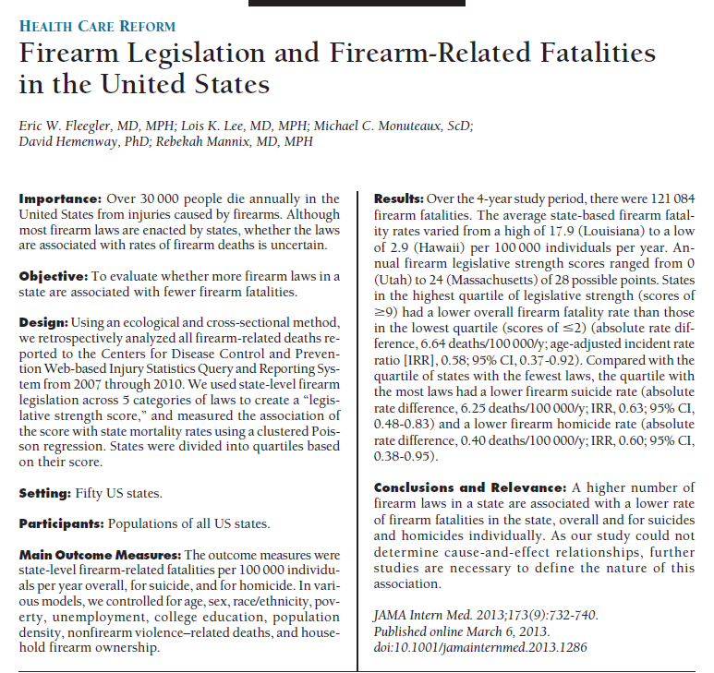

Slide 51
Populations/Generalizability
Which one?
What is our denominator?
How do we define our population?

Slide 52
Defining a Population of Interest
A population is a collection of individuals, at moments in time, defined by at least one organizing characteristic.
The definition of a population has implications for analysis, interpretation, and generalizability of results from epidemiologic studies
.

Slide 53
Simple Random Sample

Slide 55
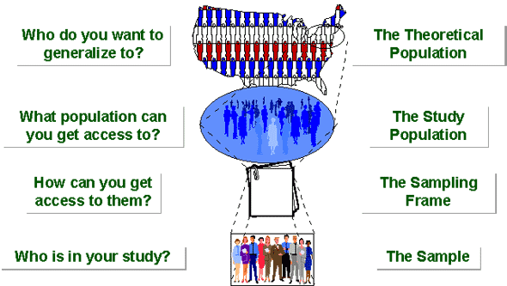
Selecting a Sample
Figure 1. Sampling Terminology (from http://www.socialresearchmethods.net/kb/sampterm.php)

Slide 56
Alternate terms you may see in the literature
Question
Who (what population) do you want to generalize to? | Theoretical population | Target population | Source population
Who is in the study? | Sample | Sample population | Study participants
Sometimes grouped together
Sometimes study population and sample
are used interchangeably
56
56

Slide 57
Examples of population-based studies that are generalizable to the population (in US)
NHANES-National Health and Nutrition Examination Survey
BRFSS-Behavioral Risk Factor Surveillance Survey
NHIS –National Health Interview Survey

Slide 58


Team project sampling examples from previous semesters
Observational cross-sectional study using simple random sampling.
Sampling frame: 19,770 UNC student email addresses
Qualtrics survey was sent to 750 people
137 students responded to the survey (18.27% response rate)
Final study sample of 123 students
We distributed the survey to 9,019 students via UNC Facebook groups and listserves
295 students completed the survey yielding a response rate of 3.27%

Slide 59
Lab this week
Ratio, Difference Measure Calculations
Discussion of Hypothesis Generating Scenarios
Team Project Planning/Discussion
What is your research hypothesis?
Who are your theoretical and study populations?
What sampling framework will you use?

Slide 60
Lab this week
Submit Prelab- Your answers to first 3 parts of lab
Towards end of lab, one team member submits in-class work
team work-answers to question 7 with your team topic
One team member posts your team topic to the discussion board

Slide 61
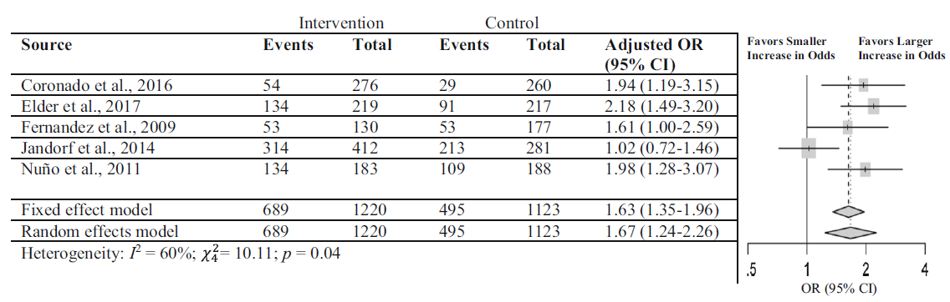
Notes:
Systematic Review of Mammography Screening Educational Interventions for Hispanic Women in the United States.
Luque JS, Logan A, Soulen G, Armeson KE, Garrett DM, Davila CB, Ford ME.
J Cancer Educ. 2018 Jan 12. doi: 10.1007/s13187-018-1321-0.
https://www.ncbi.nlm.nih.gov/pubmed/29330754

